Slide 1
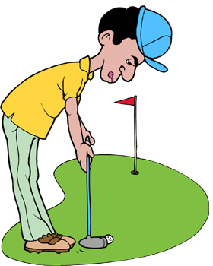
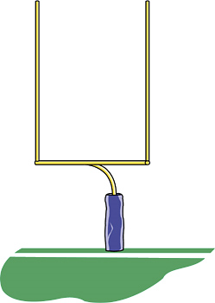
An acute angle is less than 90° .
Acute
Obtuse
Right
An obtuse angle is greater than 90° but less than 180°.
A right angle is exactly 90° .
Triple click and type your first and last name.

