Slide 1
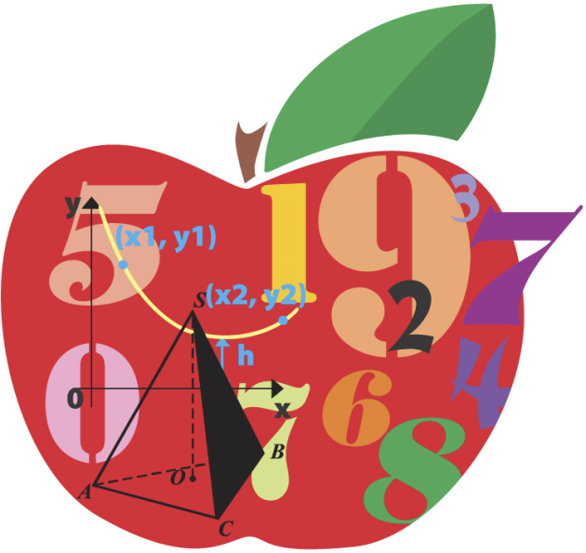
Prime & Composite
Numbers
Big Brain Publishing
Mikey Walsh
September 12, 2012
Photos from clipart.com. Used under license.
A composite number is a whole number greater than 1 with more than 2 whole-number factors.
A prime number is a whole numbers greater than 1 whose factors are itself and 1
Composite
Prime

Slide 2
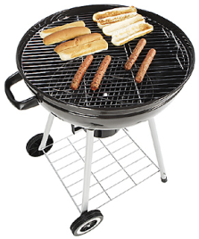
Raul bowled a 191 in the first game. | Sara earned $221 as a lifeguard. | Natalie rode the roller-coaster 23 times.
Ed ate 9 hot dogs at the picnic. | Nora sat in section 229 for the concert. | Jeremy read 39 Books.

