Slide 1
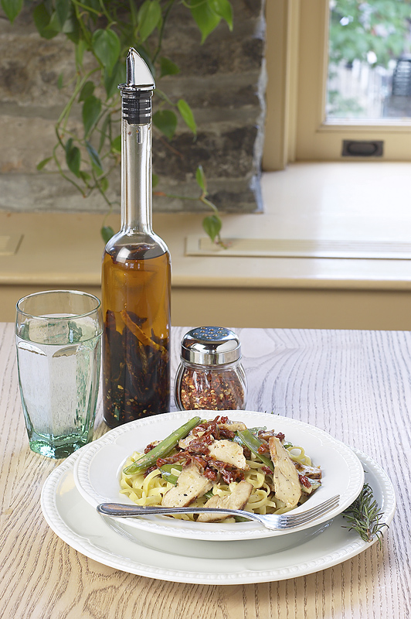
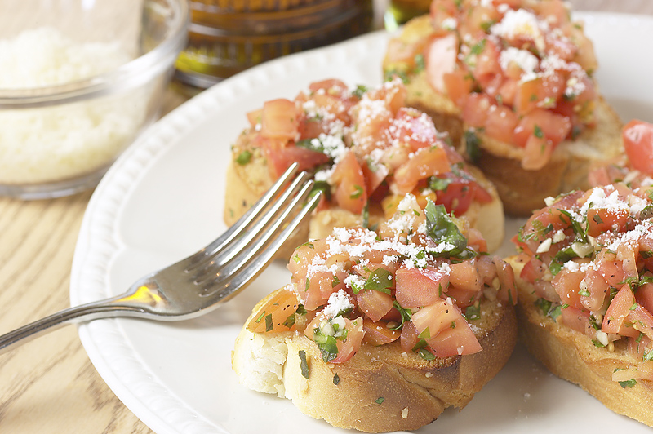
This is your cover page. Cut & discard this portion.
Giovanni’s Cucina
a project by Lawrence Cohen
All photos from clipart.com and used under license.

Slide 2
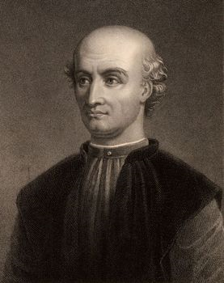
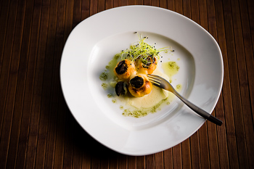
Antonio’s Favorite
Antonio’s Favorite
Stuffed Mushrooms
Chicken Marsala
Cheesecake
Regular Price: $27.69
Combo Price: $22.95
Savings: 17%
Cut & discard this portion!

Slide 3
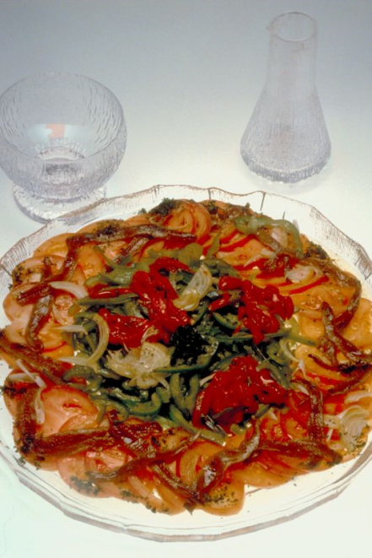
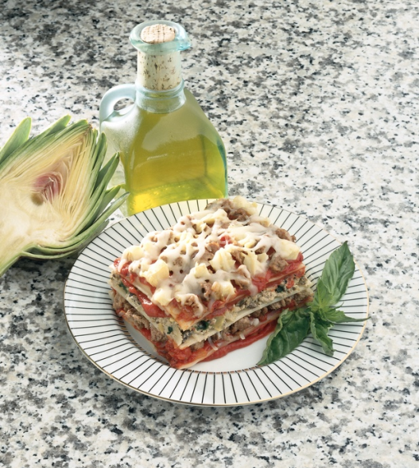
Fratelli Plate
Cut & discard
this portion!
Escargot
Lasagna
Tiramisu
Regular Price: $31.85
Combo Price: $24.99
Savings: 22%
Fratelli Plate
Cut & discard this portion!

Slide 4
Nonna’s Segreto
Bruschetta
Chicken Marsala
Orange Sorbet
Regular Price: $24.95
Combo Price: $19.95
Savings: 20%
Cut & discard this portion!
Nonna’s Segreto
Cut & discard
this portion!

Slide 5
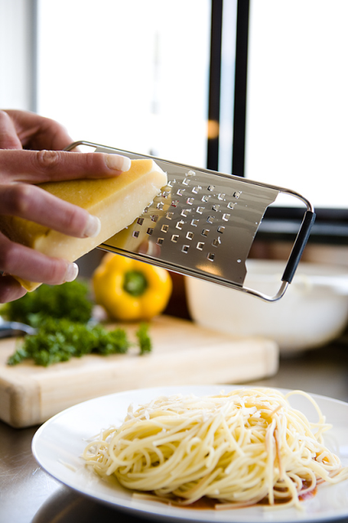
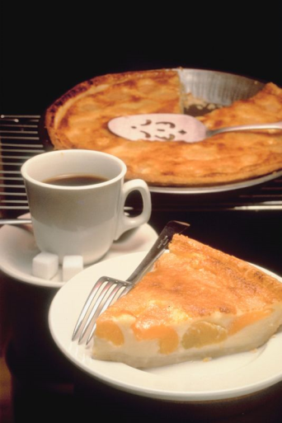
Zio Adolfo
Fried Mozzarella Sticks
Fettuccine Alfredo
Spumani
Regular Price: $26.85
Combo Price: $21.00
Savings: 22%
Cut & discard this portion!
Zio Adolfo

