Slide 1
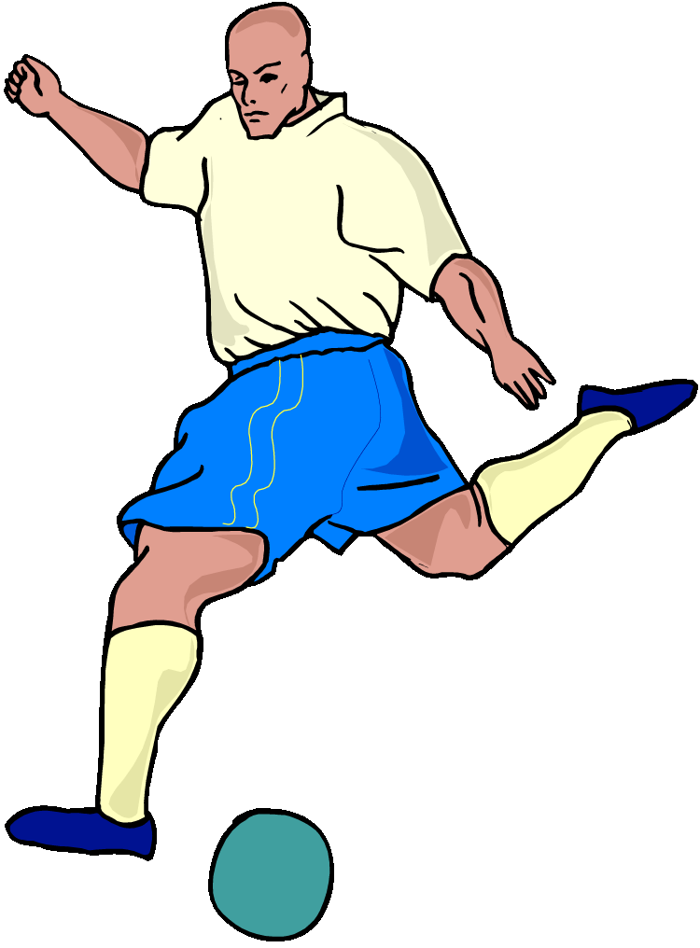
Transformations
Translation
an exact duplication of a figure formed by moving each point in the figure the same distance and in the same direction
sometimes called a slide
Moment of Brilliance Publishing Co.
© 2009
by Neal Schon
results in a mirror image of it. The object and the image are equal distance from the line of reflection
sometimes called a flip
the image is formed by turning the figure about a fixed point which may be inside or outside the figure.
Rotation
Reflection

